Slide 1
ANALYTIC TOOL FOR HEALTHCARE DATA OF PATIENT’S HEART DISEASE PREDICTIONS IN HOSPITALS AND OTHER INSTITUTIONS USING MACHINE LEARNING
S Varusha (210701304)
G Udhaya Kumar (210701293)
R Sathish Kumar (210701515)

Slide 2
PROBLEM STATEMENT
Heart disease remains one of the leading causes of morbidity and mortality worldwide, presenting a significant public health challenge. Hospitals and healthcare institutions collect vast amounts of data on heart disease patients, including demographic information, clinical parameters, diagnostic test results, and treatment outcomes. Leveraging this data through advanced analytics can significantly enhance the understanding and management of heart disease, improving patient outcomes and healthcare efficiency. The problem statement for the Heart Disease Prediction Project is to develop an accurate and reliable predictive model that can assess an individual's risk of heart disease based on a wide range of health-related data set.

Slide 3
ABSTRACT
This abstract offers a concise overview of the tool's objectives, functionalities, impact, and significance in the healthcare industry, aiming to highlight its role in advancing patient care through innovative data analytic. This paper introduces a sophisticated analytics tool specifically designed to address the complexities and scale of healthcare data. In the real time of healthcare for patients is the effective management and analysis of patient data across hospitals and other healthcare institutions are paramount for improving patient outcomes in diseases.

Slide 4
EXISTING SYSTEM
The existing system for the project "Analytic Tool for Healthcare Data of Patient's Heart Disease Predictions in Hospitals and Other Institutions Using Machine Learning" encompasses a comprehensive infrastructure. It involves the systematic collection of healthcare data, including patient’s medical records, diagnostic tests, and lifestyle information. This data undergoes preprocessing to ensure accuracy and consistency before feature engineering to extract relevant predictors for heart disease prediction. Machine learning models, ranging from traditional algorithms like logistic regression to more complex ones are employed to analyze this data and generate predictive insights. Model performance is evaluated through various metrics, and the best-performing models are integrated into user-friendly interfaces accessible to healthcare professionals. Continuous monitoring and periodic updates ensure the systems reliabilit in healthcare providers in making informed decisions regarding patient care standards for data privacy and security.

Slide 5
PROPOSED WORK
1. Data Collection:
Gather a comprehensive dataset that includes relevant health information such as patient demographics, medical history, lifestyle factors, and diagnostic test results (e.g., cholesterol levels, blood pressure, ECG readings).
2. Data Preprocessing:
Clean and preprocess the data to handle missing values, outliers, and ensure data consistency. Normalize or standardize numerical features to bring them to a common scale. Encode categorical variables appropriately

Slide 6
CONTINUOUS…..
3. Feature Selection:
Identify and select the most relevant features for heart disease prediction using techniques like feature importance analysis or dimensionality reduction methods.
4. Support Vector Machines (SVM)
SVM is a supervised machine learning algorithm that can be used for classification and regression tasks. In the context of heart disease prediction, SVM can be employed to classify individuals into different categories (e.g., presence or absence of heart disease) based on input features such as age, blood pressure, cholesterol levels, etc.

Slide 7
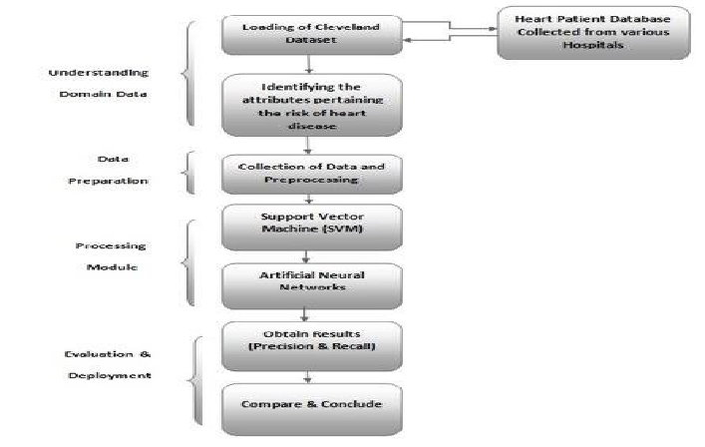
ARCHITECTURE DIAGRAM

Slide 8
MODULES
1. DATA COLLECTION
2. DATA PREPROCESSING
3. DATA TRAINING
4. DATA TESTING

Slide 9
EXPLANATION OF EACH MODULE
DATA COLLECTION:
It allows to capture a record of past events so that we can use data analysis to find recurring patterns build predictive model.
DATA PREPROCESSING:
It is the process of generating data for machine learning models.
DATA TRAINING:
The data allows to train a machine learning algorithm or model from the large dataset.
DATA TESTING:
In machine learning we use testing data to ensure the model works for the given testing data.

Slide 10
HEARTS ABNORMALITY OF THE PATIENT’S
Too slowly
Too quickly
Irregularly
Mercury is the closest planet to the Sun and the smallest of them all
Venus has a beautiful name and is the second planet from the Sun
Despite being red, Mars is actually a cold place. It’s full of iron oxide dust

Slide 11
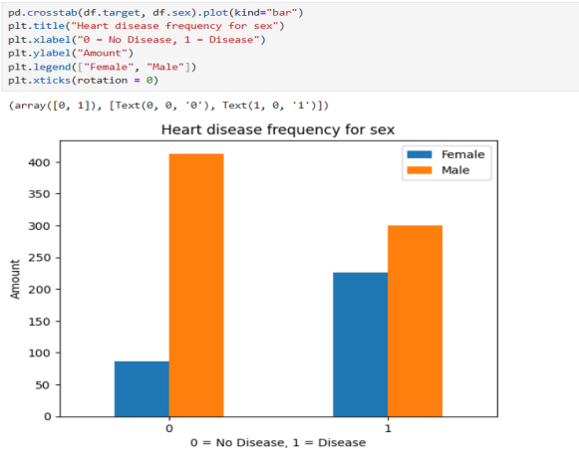
RESULT AND DISCUSSION

Slide 12
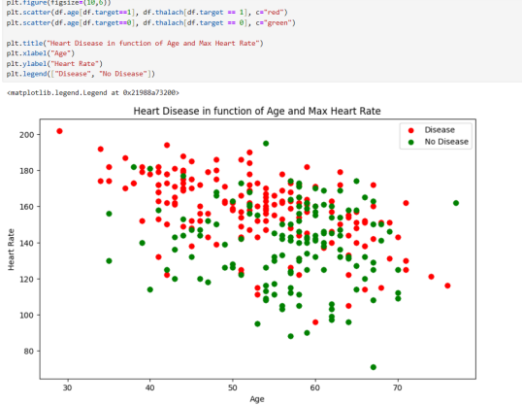
CONT...

Slide 13
CONCLUSION
The proposed model successfully demonstrates the potential of machine learning in transforming healthcare by providing accurate and timely predictions of heart disease. By leveraging advanced algorithms and comprehensive patient data, the tool enhances diagnostic accuracy, facilitates early intervention, and ultimately improves patient outcomes. The integration of this predictive analytic tool into healthcare settings can streamline clinical decision-making, optimize resource allocation, and contribute to personalized patient care. This project underscores the critical role of technology in advancing medical practice and underscores the importance of continuous innovation in the healthcare sector.

Slide 14
FUTURE ENHANCEMENT
Predictive Analytics for Treatment Response:
Extend the capabilities of the tool to predict the effectiveness of different treatment options for patients with heart disease. This could help healthcare providers make more informed decisions about treatment plans.
Longitudinal Data Analysis:
Incorporate longitudinal data analysis to track changes in patient health over time. This could help identify patterns or trends that are not apparent from individual snapshots of patient data.

Slide 15
REFERENCES
[1] “Heart Disease Prediction using Machine Learning Techniques, 2020”, by Devansh Shah, Samir Patel & Santosh Kumar Bharti
[2] “Heart disease prediction using machine learning algorithms, 2021” by
Harshit Jindal, Sarthak Agrawal, Rishabh Khera, Rachna Jain and Preeti Nagrath
[3] “Effective Heart Disease Prediction Using Hybrid Machine Learning Techniques , 2019” by Senthilkumar Mohan; Chandrasegar Thirumalai; Gautam Srivastava
[4] “Heart Disease Prediction using Hybrid machine Learning Model, 2021” by
M. Kavitha; G. Gnaneswar; R. Dinesh; Y. Rohith Sai; R. Sai Suraj

Slide 16
CONT...
[5] “Heart disease prediction using supervised machine learning algorithms:
Performance analysis and comparison, 2021” by Md Mamun Ali , Bikash Kumar
Paul , Kawsar Ahmed , Francis M. Bui , Julian M.W. Quinn , Mohammad Ali Moni
[6] “Heart Disease Prediction Using Machine learning and Data Mining
Technique, 2016” by Jaymin Patel, Prof.Tejal Upadhyay, Dr. Samir Patel
[7] “Machine Learning Techniques for Heart Disease Prediction: A Comparative Study and Analysis, 2020” by Rahul Katarya & Sunit Kumar Meena
[8] “Latest trends on heart disease prediction using machine learning and
image fusion, 2021” by Manoj Diwakar , Amrendra Tripathi , Kapil Joshi , Minakshi
Memoria , Prabhishek Singh , Neeraj kumar

Slide 17
THANKS!!!

